Slide 1


Paper to Power:
Mastering Digital Migration
Rob Mattern
President
April 14, 2026

Slide 2
Agenda
Introduction
Learning Objectives
What is Digital Migration?
Getting the “Firm” On Board
What Do You Need?
Where Do You Start?
What is Going to Derail You?
Questions

Slide 3
Learning Objectives
Understand the core elements of digital migration
Learn what systems and processes are most commonly transitioned in legal environments
How to select the right tools for workflow automation and document storage
How to build and implement a digital migration plan – and how to get Management on board

Slide 4
What is Digital Migration?
Digital Migration is the structured transition
of a business’s people, documents, processes and systems
into secure digital workflows
that improve efficiency, compliance, collaboration and
client services.

Slide 5
Getting Management On Board
  Cost
    1.2 CF box - 5,000 sheets
    Assume scanning all 5,000 pages
    50% - 70% of paper is already in digital format
Storage | Cubic Foot Cost
Off-site, 10 years and destroy | $44.63
Digital, 10 years and destroy | $350

Slide 6
Getting Management On Board
  Ease of access – Hybrid
  AI
  Other factors
    Soft costs (6 hours versus 3 hours)
    Cost of floor space

Slide 7
What Do You Need?
Implementable IG Plan that addresses electronic & paper records
Business Management System
Document Management System (DMS)
Workflow Scanning System/Mail Scanning

Slide 8
Where Do You Start?
  Document Management
  Billing/Timekeeping/Payments
  Business Intake/Contracts
  Practice Management System

Slide 9
What is Going to Derail You?
  Paper-based people
  Leadership/Ownership
  Standardization/Workflow improvement
  Change management
  Measuring success
  Weak training

Slide 10
Questions

Slide 11
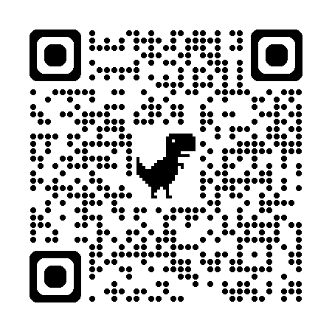
rmattern@matternassoc.com

